Slide 1
Wednesday, September 28, 2016
Write In Your Agenda:
Write In Your Monitoring Log:
CW:
Ring of Fire video and video sheet
HW:
None
Response to Warm-Up:
What is the Ring of Fire, where is it located and why is it called that??
You will need:
Pencil

Slide 2
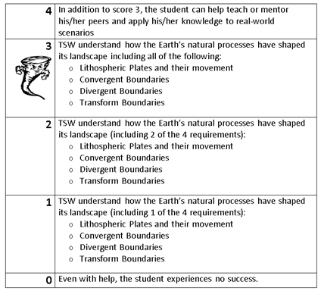
Learning Goal and Scale
TSW understand how the Earth’s natural processes have shaped its landscape (including Lithospheric Plates and their movement, Convergent, Divergent, and Transform boundary landforms).

Slide 3
Take the quiz.
Hand in your quiz and privacy folder.
Read pages 162-168 and complete guided reading sheets.

